Slide 1
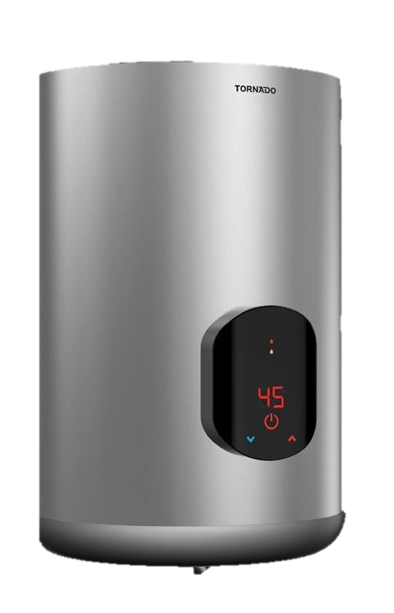
Electric Water Heater
Project
GRADUATION PROJECT

Slide 2
TABLE OF CONTENTS
01
02
03
04
06
OUR TEAM
MAJOR REQUIREMENT
FLOWCHART OF PROJECT
Code STAGES

Slide 3
01
TEAM
EID ELSAYED OKDA
eidelsayed2512@gmail.com

Slide 4
02
MAJOR REQUIREMENTS

Slide 5
MAJOR REQUIREMENTS
The “Up” or “Down” buttons are used to change the required water temperature (set temperature).
The first “Up” or “Down” button press, enters the temperature setting mode.
After entering temperature setting mode, a single “Up” button press increase the set temperature by 5 degrees.
After entering temperature setting mode, a single “Down” button press decrease the set temperature by 5 degrees.
The minimum possible set temperature is 35 degrees.
The maximum possible set temperature is 75 degrees.
The “External E2PROM” should save the set temperature once set.
If the electric water heater is turned OFF then ON, the stored set temperature should be retrieved from the “External E2PROM”.
The initial set temperature is 60 degrees.

Slide 6
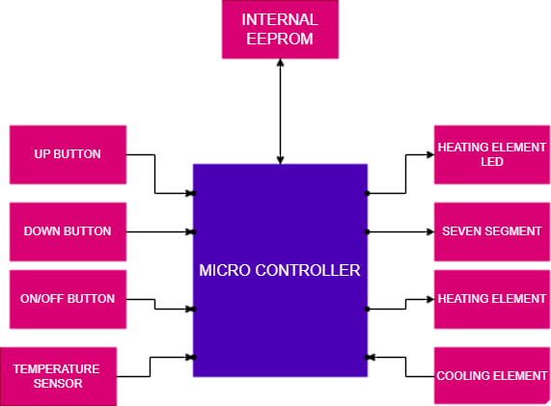
components
INPUTS
BUTTONS –
TEMPERATURE SENSOR
OUTPUTS
HEATER – COOLER – LED –
SEVEN SEGMENT DISPLAY

Slide 7
03
FLOWCHART

Slide 8
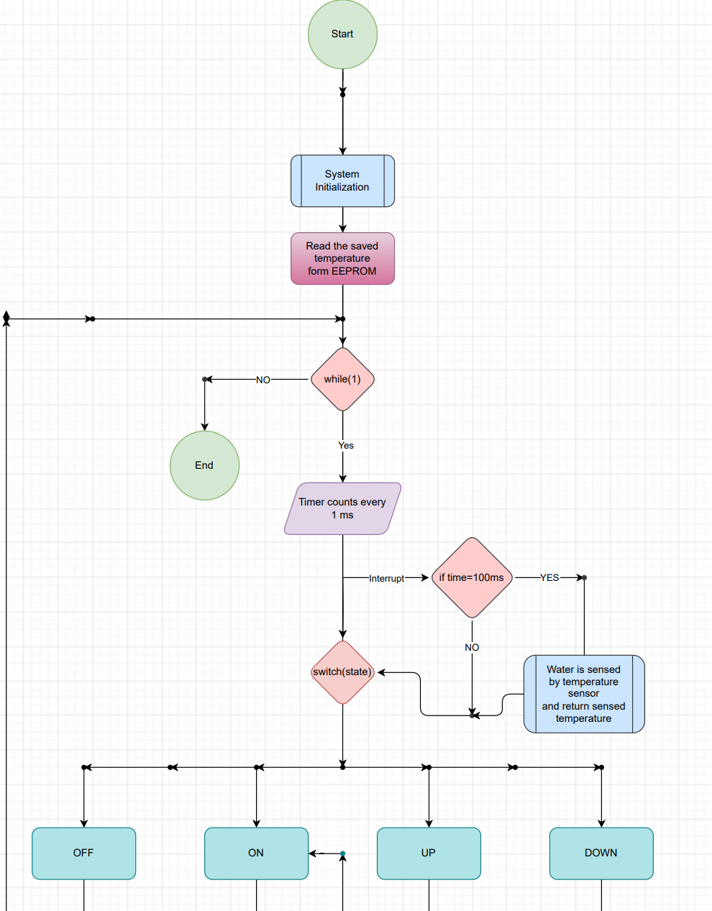

Slide 9
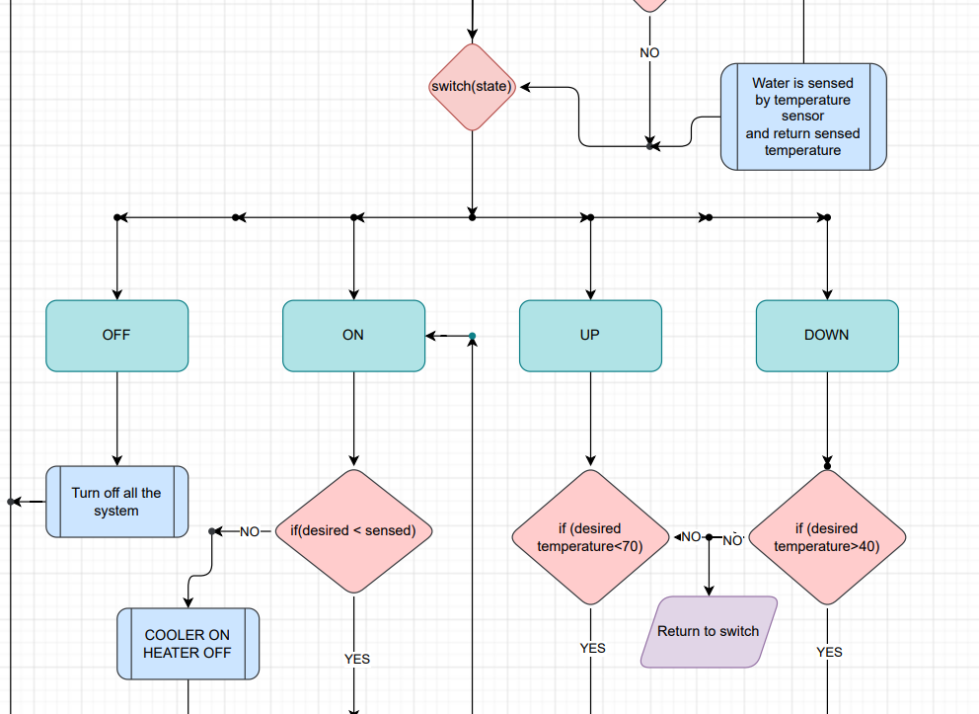

Slide 10
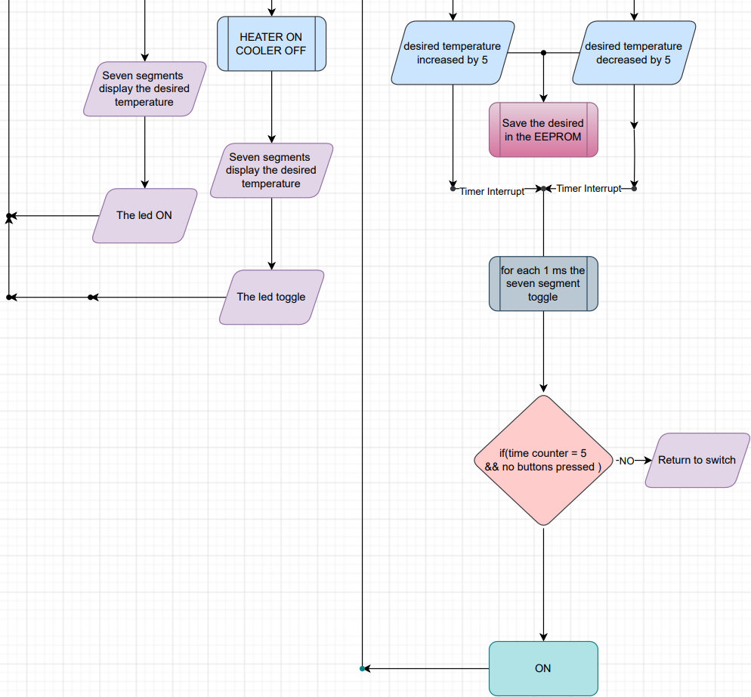

Slide 11
04
CODE STAGES

Slide 12
WHAT I AM WORKING ON
01
02
03
MCAL
HAL
API
ADC – INTERRUPTS – TIMER – EEPROM – I2C
LED – HEATER – COOLER – SEVEN SEGMENT –BUTTONS – EEPROM
HANDLING THE SYSTEM

Slide 13
The first design

Slide 14
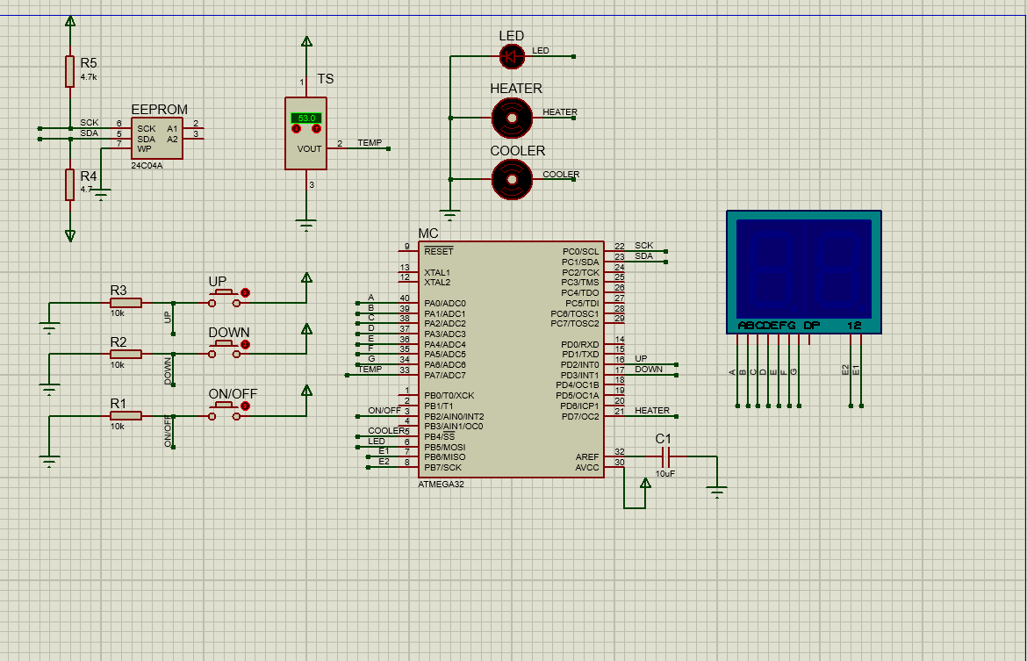
The final design with labels

Slide 15
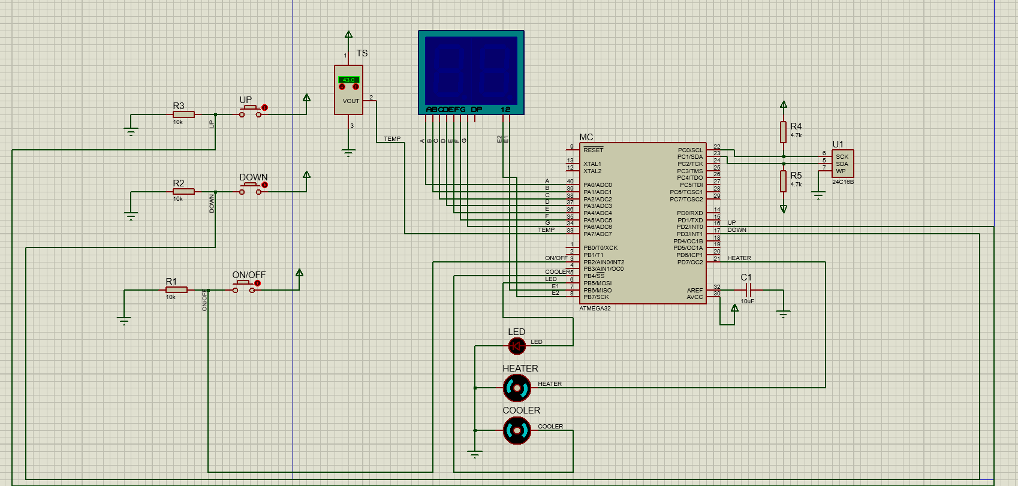
The final design without labels

Slide 16

DESKTOP SOFTWARE

